Slide 1



How to build a rocket
X Student Astronomical Workshow Novi Sad, 2017
Marina Petrović

Slide 2
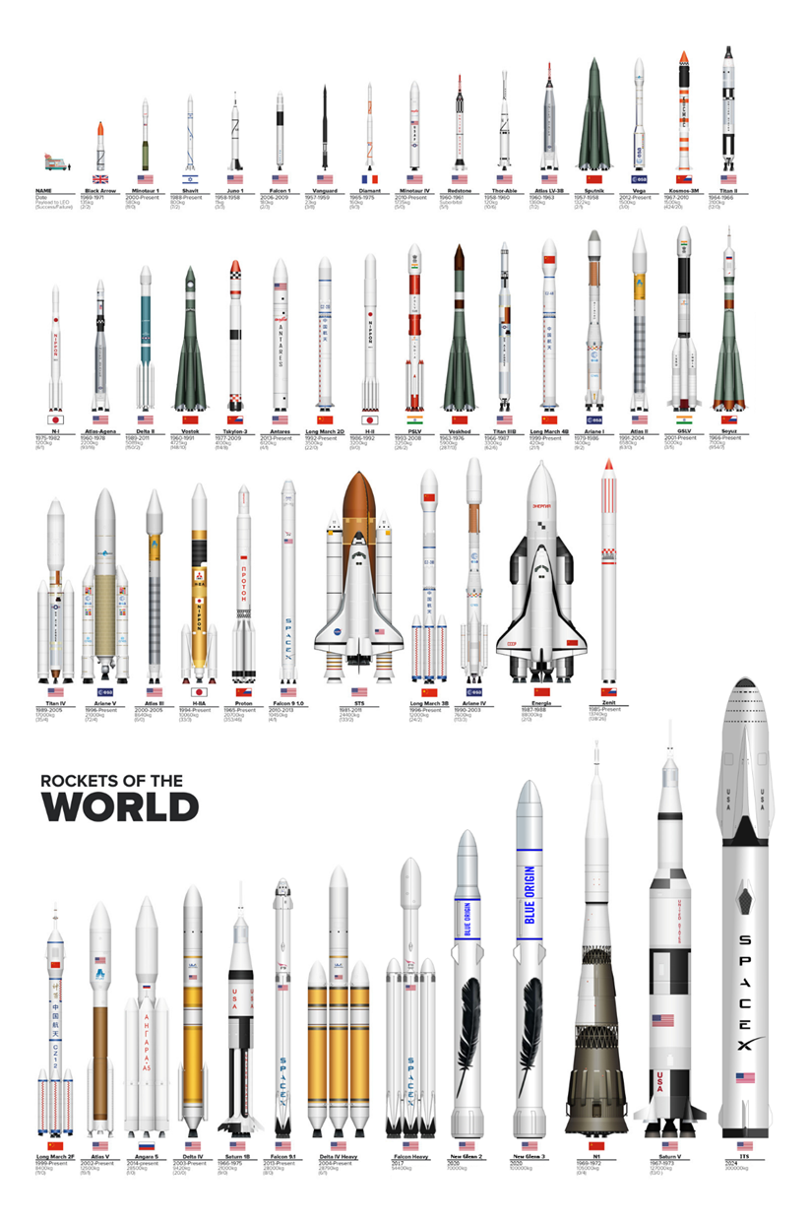
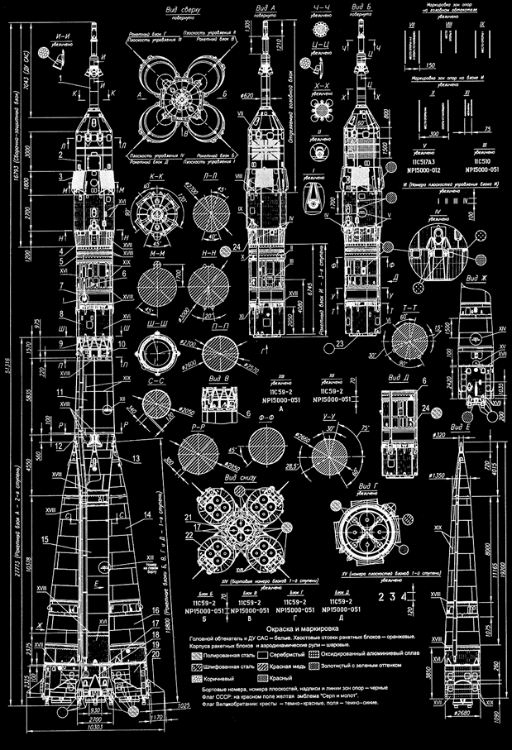
It’s a Rocket Science!

Slide 3
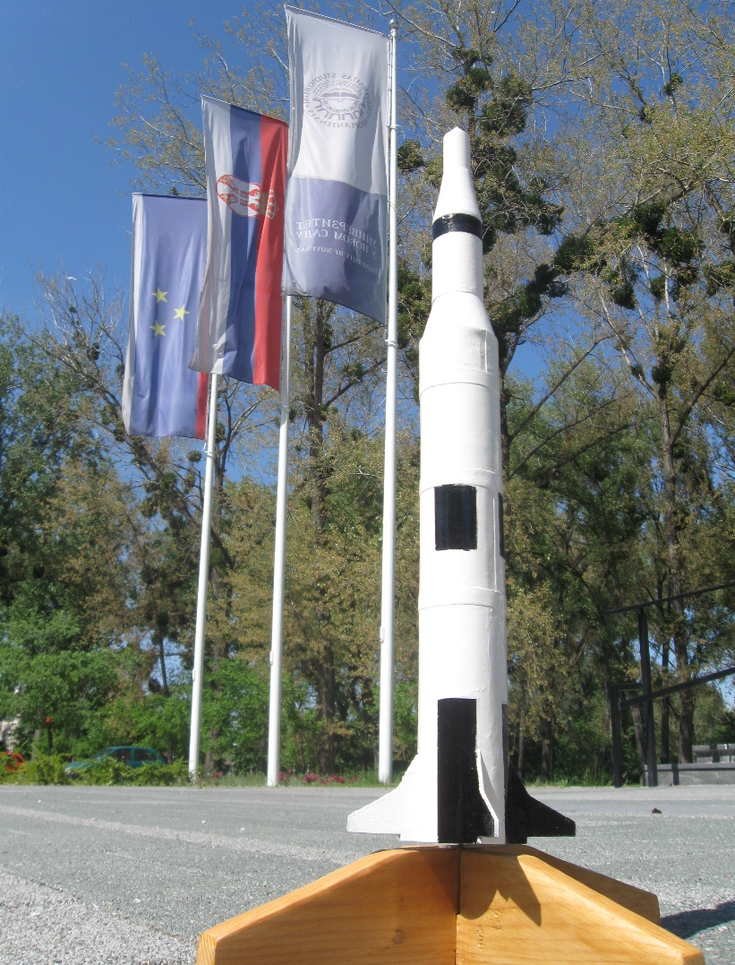
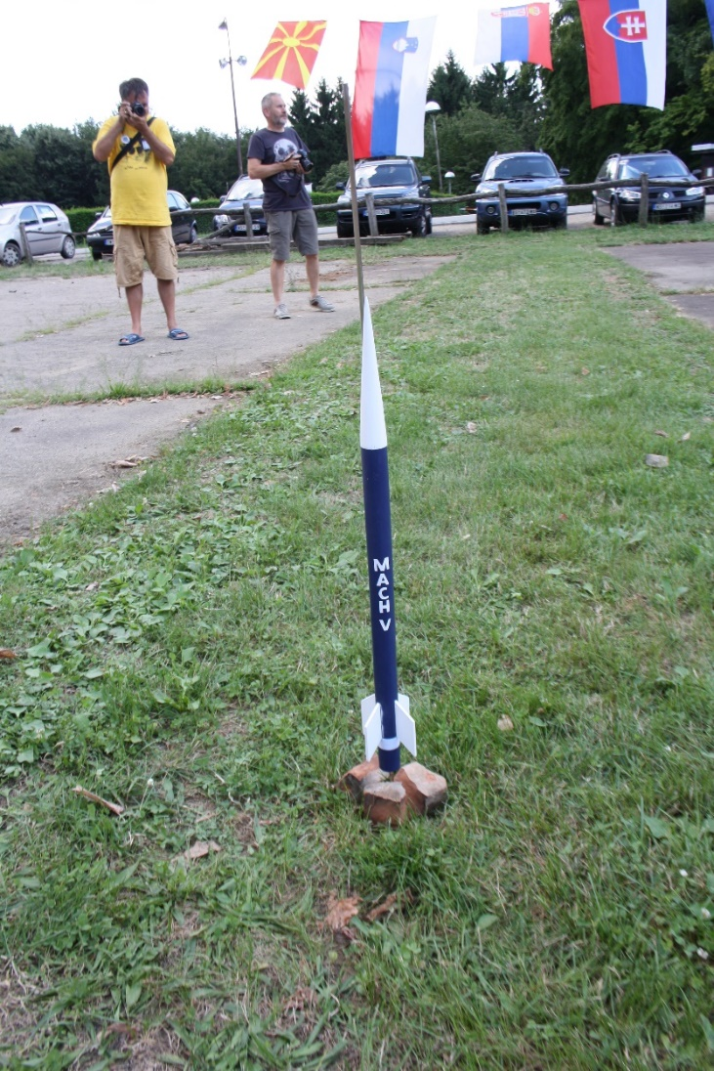

MachV projects

Slide 4
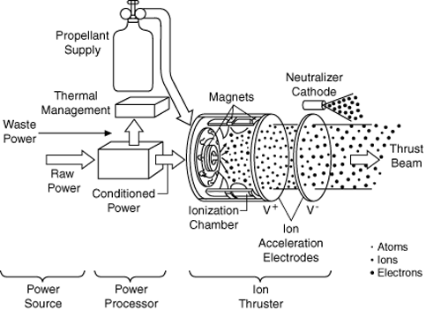
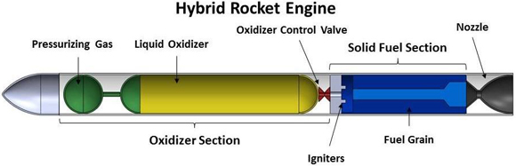
How to build a rocket
First choose engine!
Engines use propellant: fuel and oxidizer.
Burning fuel and oxidizer → release high-pressure gas → produce thrust in accordance with Newton's third law
Classes of propulson systems:
Solid rocket engines
Liquid rocket engienes
Hybrid rocket engines
Ionic rocket engines

Slide 5
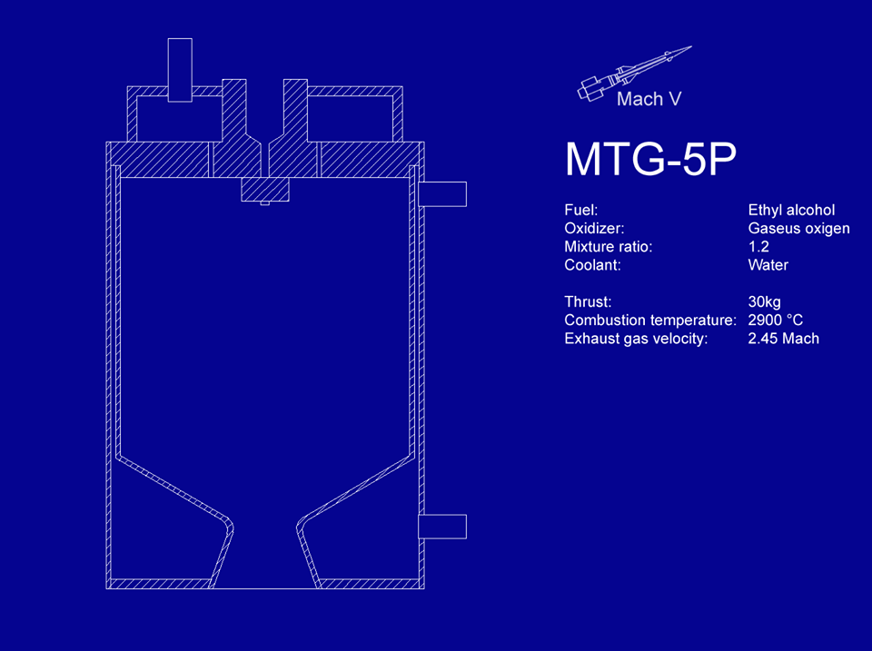
Liquid propellant system
Combustion chamber:
Fuel and oxidizer in liquid state → high temperature →
Cooling chamber
Advantage:
Good choice if project request engine control
Efficient
Disadvantages:
Expensive
Additional mass

Slide 6
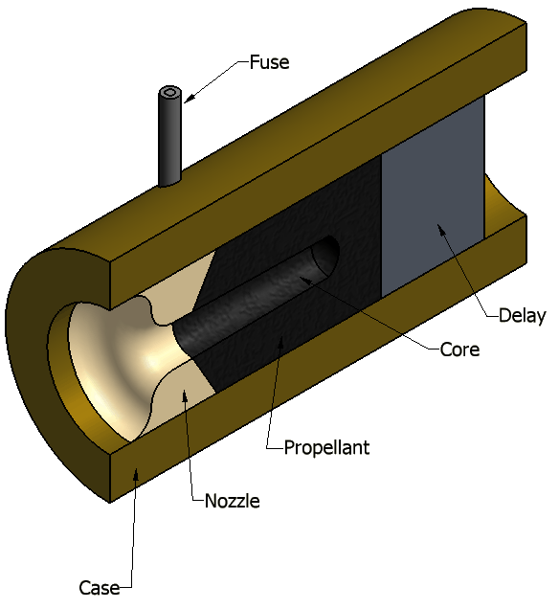
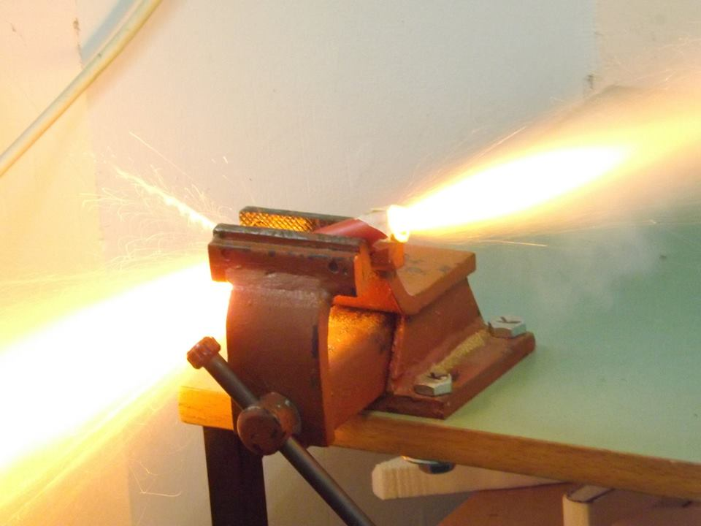
Solid propellant system
Advantages:
Good amounts of thrust
It is simple
Inexpensive
Disadvantage:
It can never be switched off!

Slide 7
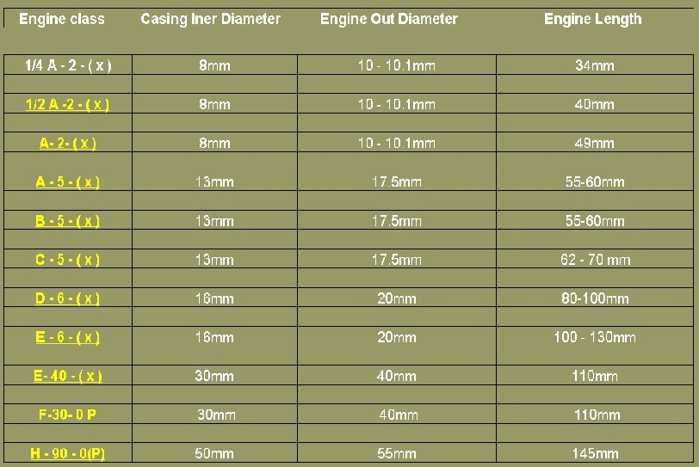
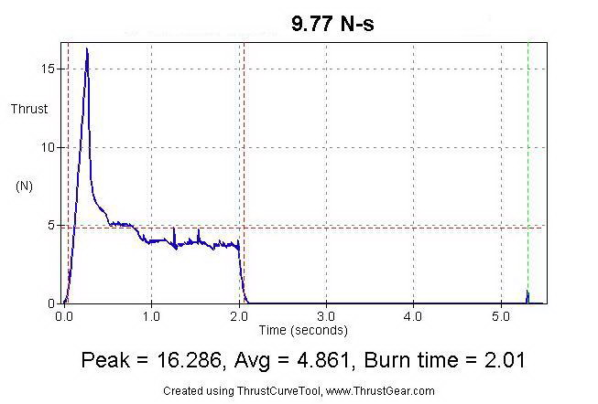
Classification by total impulse and average thrust
Categories from A to O, model rocket use classes from A to H
Example: C6-3
C - engine’s total impulse (Ns)
6 - average thrust (N)
3 - delay (s)
The rule: rocket weight
must be 3 time less then
engine’s average trust!

Slide 8
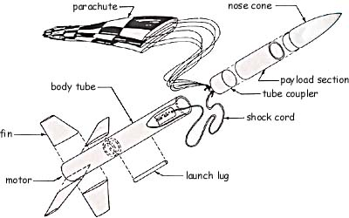
Correct materials for rocket’s parts
Light-weight but strong:
Paper, wood glue for body tube
Wood(plastic) for fins, nose cone, engine mount
Nylon fabric for parachute
Elastic shock cord

Slide 9
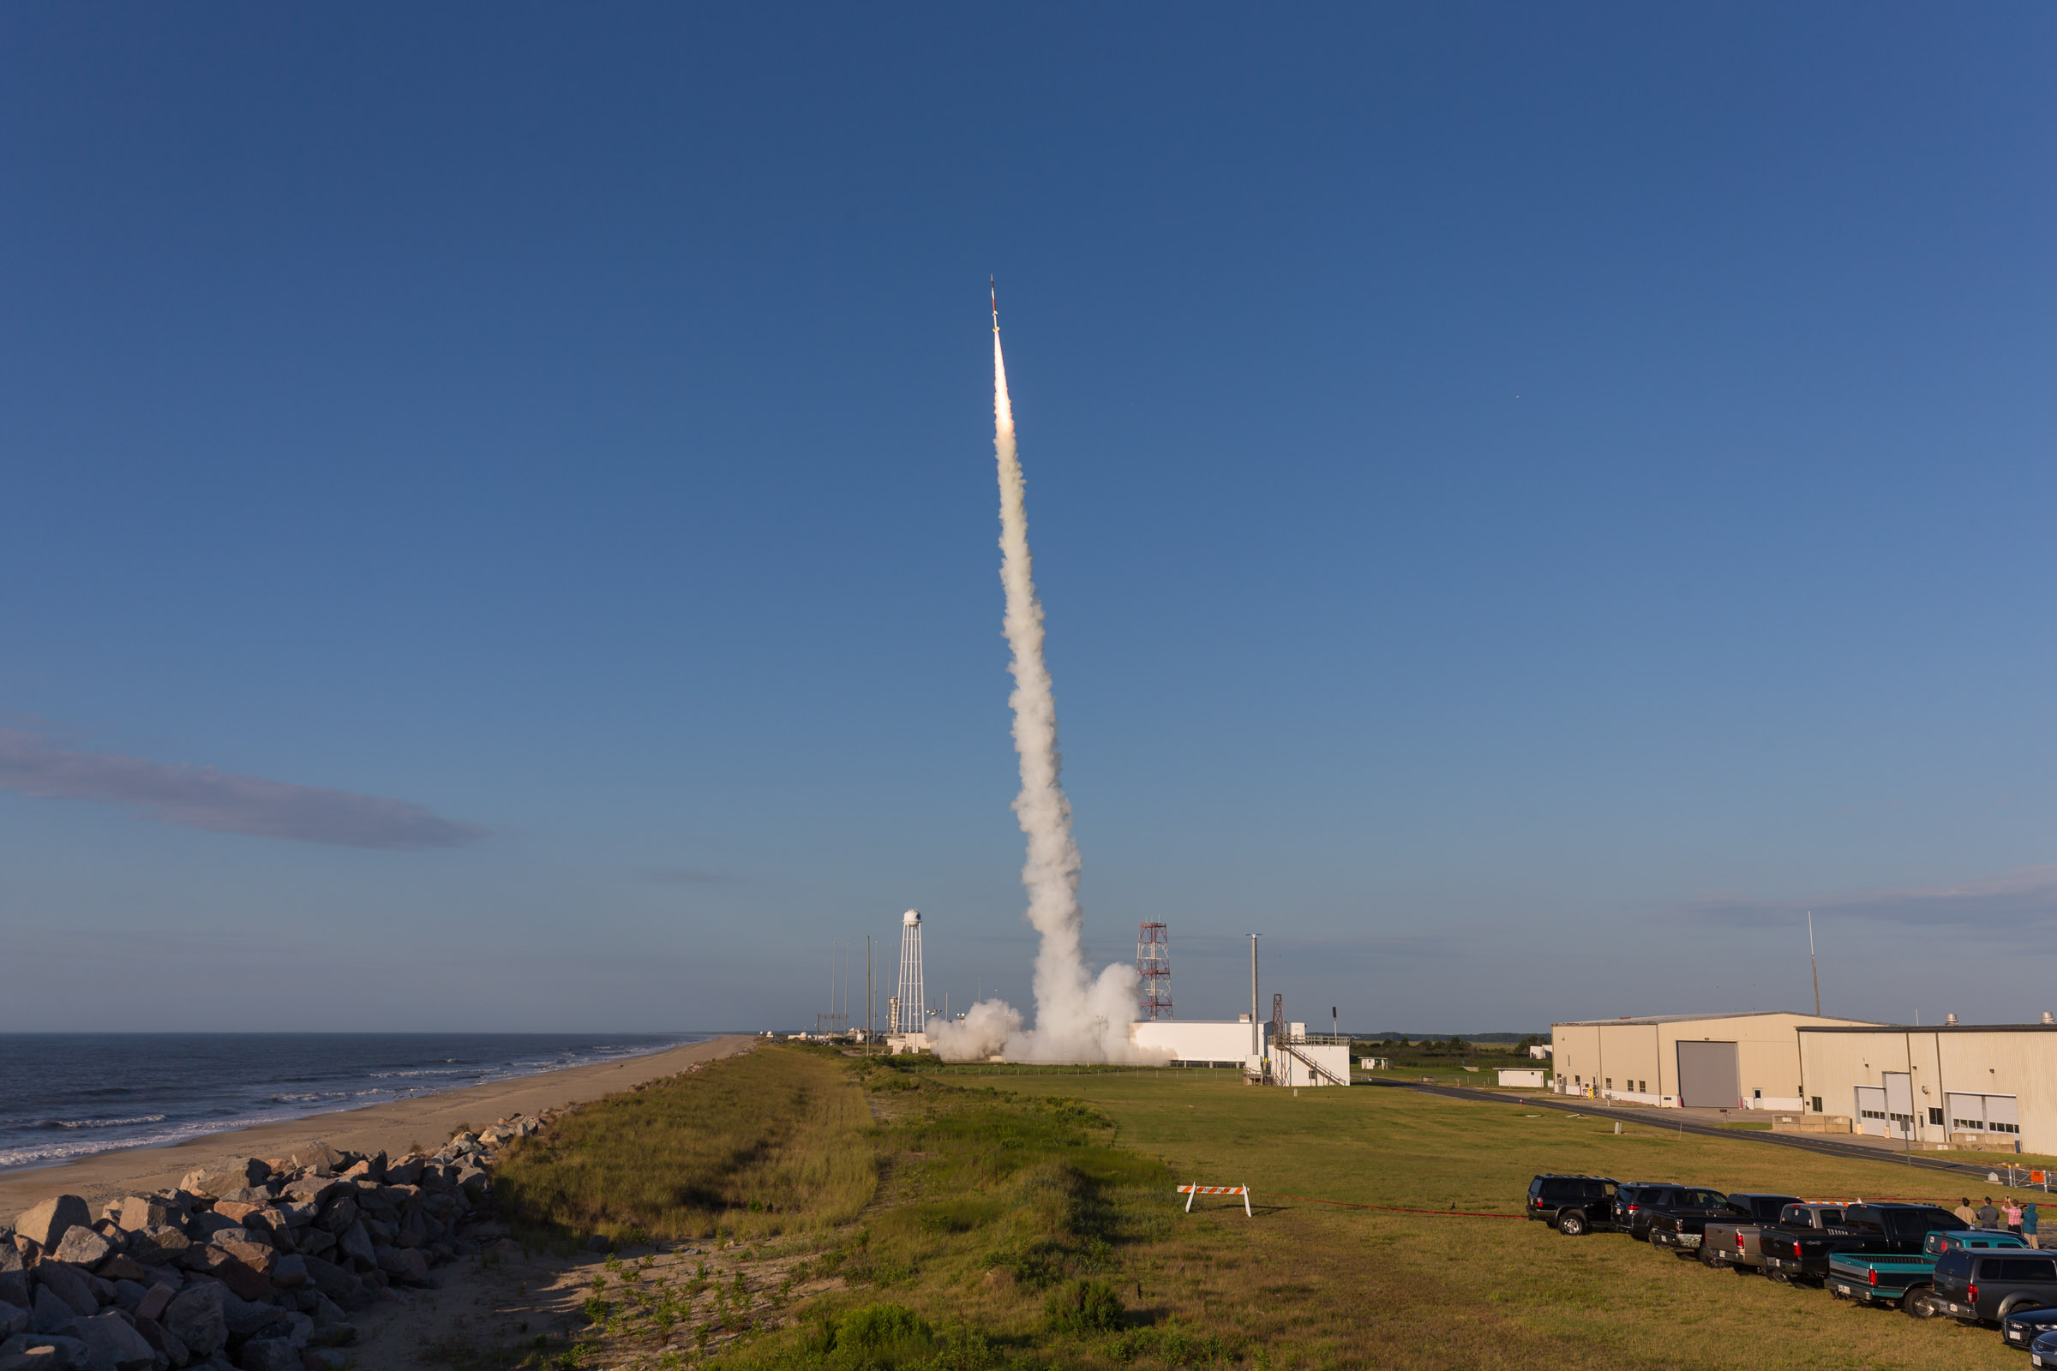
Stability
Affected by:
Design and shape of the rocket
Length of launch rail
The environmental conditions
Expressed by a number:
Ratio between center of mass and center of pressure of the rocket

Slide 10
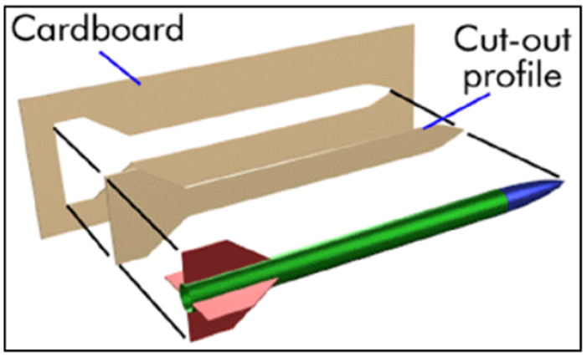
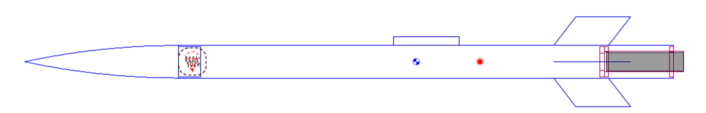
Passive stabilization
The center of mass is the point along the length at which it balances
The center of pressure is the point along the length of the rocket at witch aerodynamic force acts
Ideal stability : between 1 and 2

Slide 11
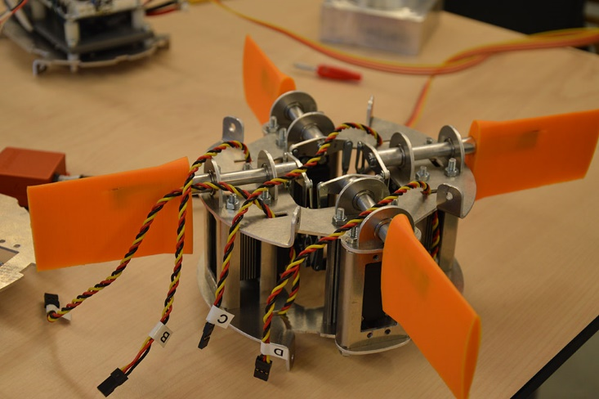
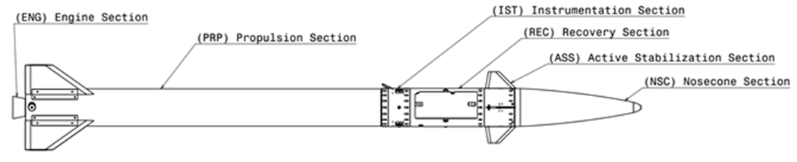
Active stabilization
Electromechanical control system to detect disturbance and correct course of the rocket:
movable fins
nozzles
thrusters

Slide 12

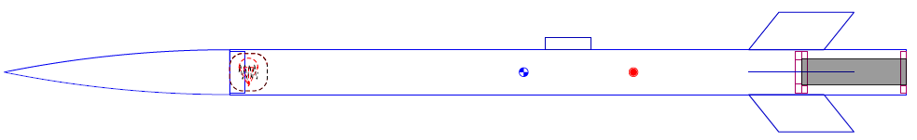
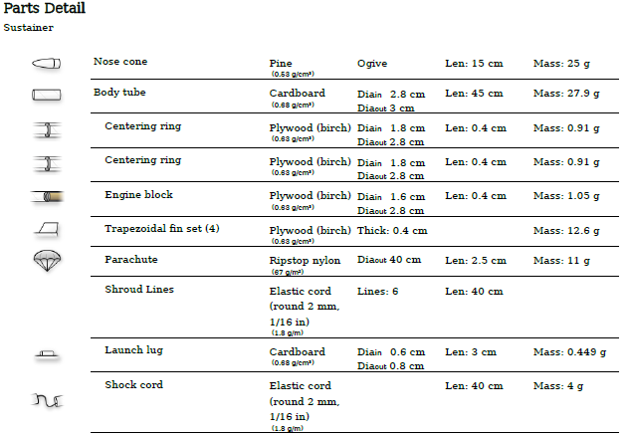
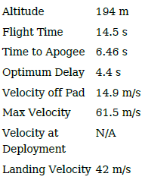
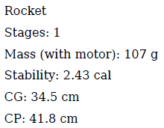
C5-5 engine:
CG = center of mass
CP = center of pressure

Slide 13

Summary
Choose engine √
Make design √
Create parts √
Verify stability √
↓
Simulation
↓
Test flight → Rocket is ready!

Slide 14
Thank you!
Where to buy egine:
Istraživački raketni centar (IRC): http://www.raketnicentar.com/
Software for desigh of rocket, and flight simulation:
http://openrocket.info
Mach V mail:
rdmachv@gmail.com

