Slide 1
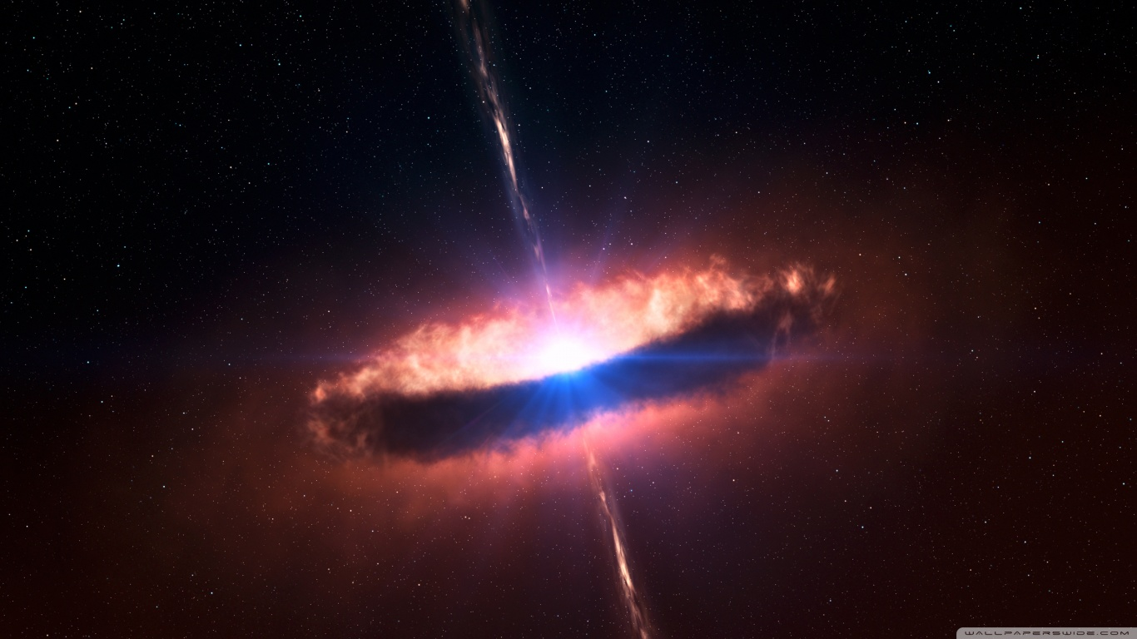
MODELS OF EMISSION LINE PROFILES
AND SPECTRAL ENERGY DISTRIBUTIONS
TO CHARACTERIZE THE MULTI-FREQUENCY
PROPERTIES OF ACTIVE GALACTIC NUCLEI
ABHISHEK CHOUGULE
Astromundus edition 7

Slide 2


Slide 3

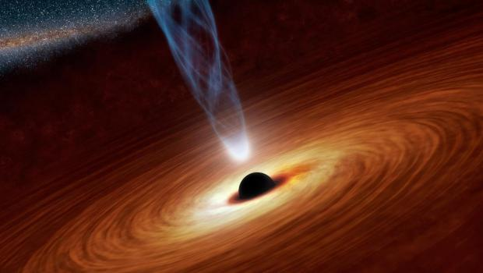

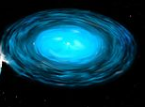
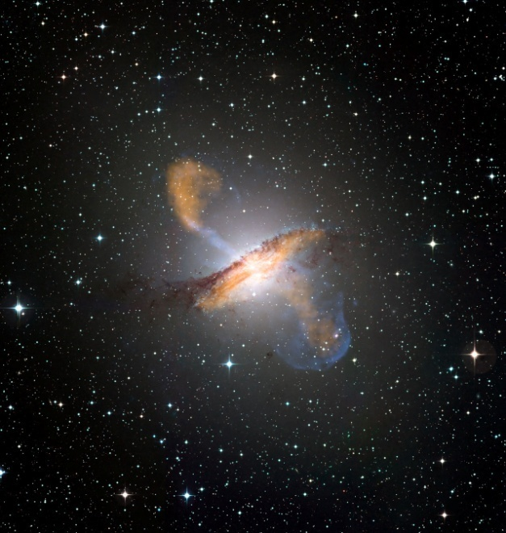
What are AGNs?
+

Slide 4
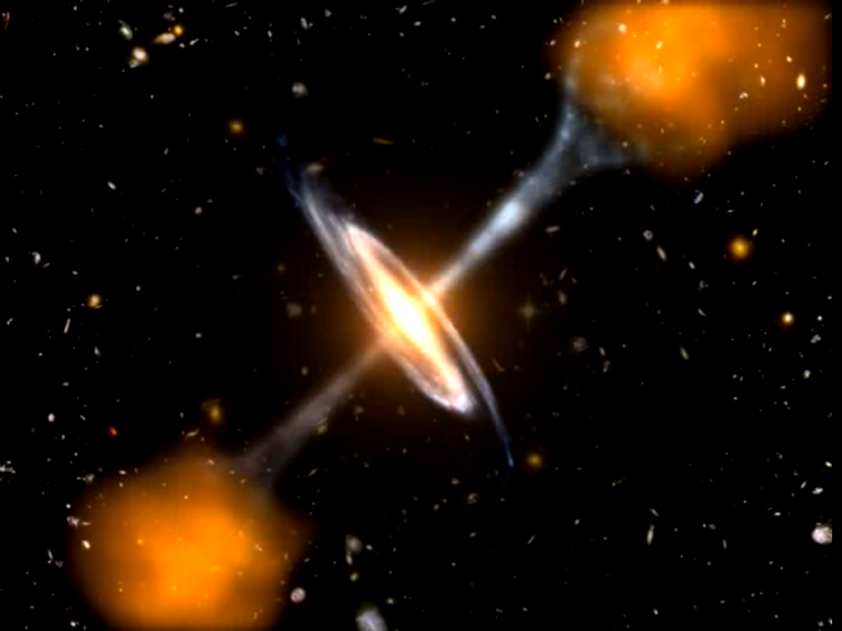

Slide 5
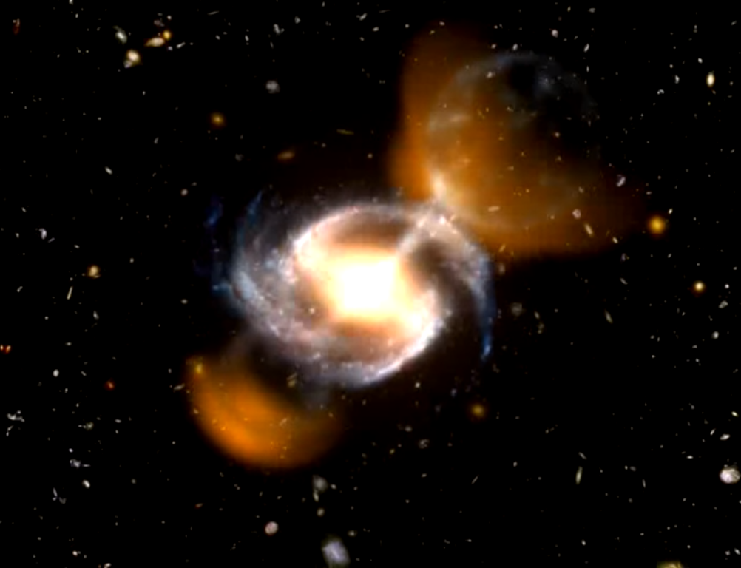

Slide 6
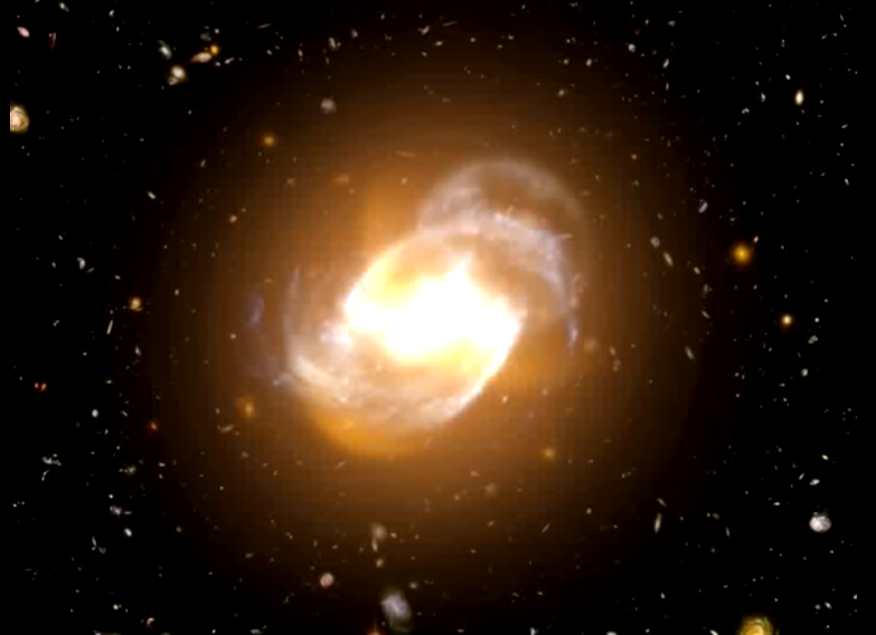

Slide 7
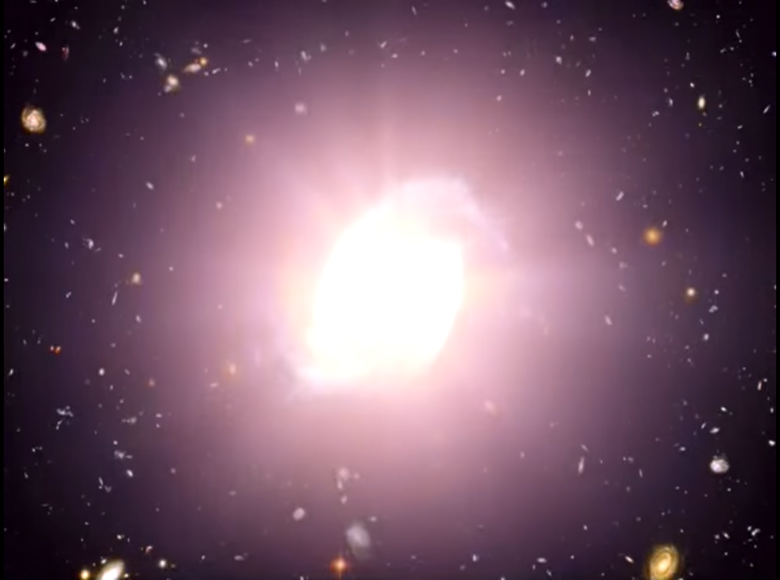

Slide 8
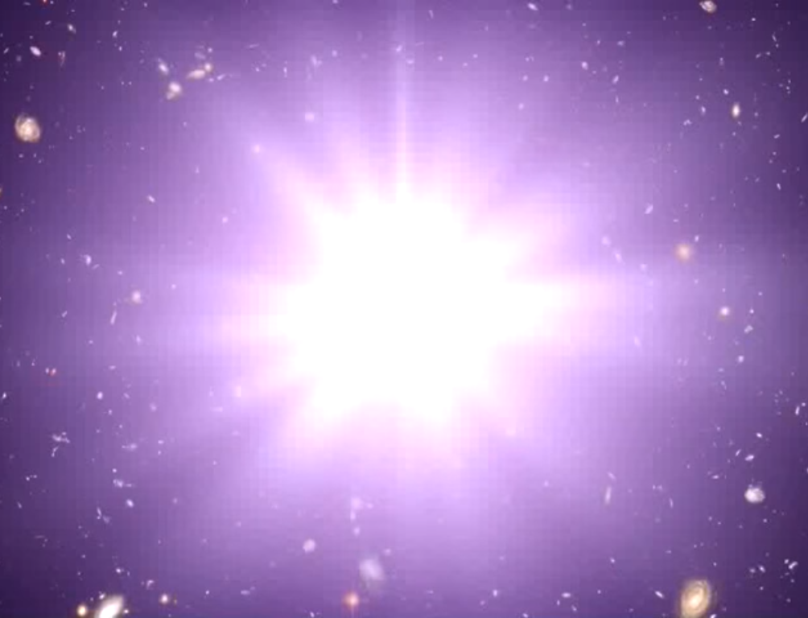

Slide 9
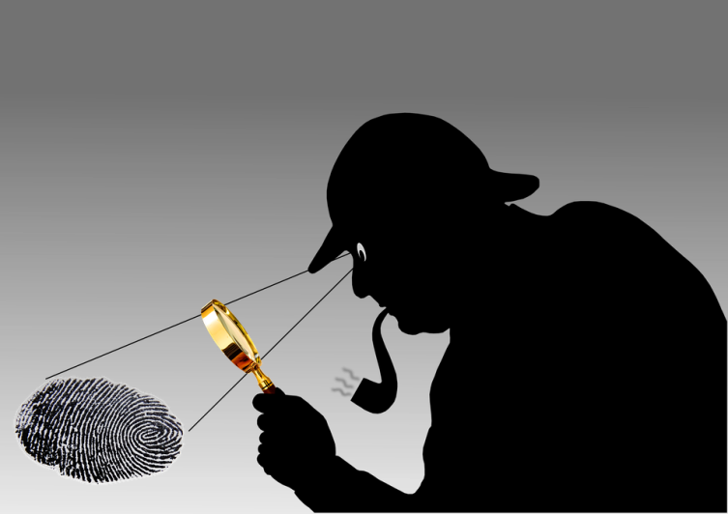
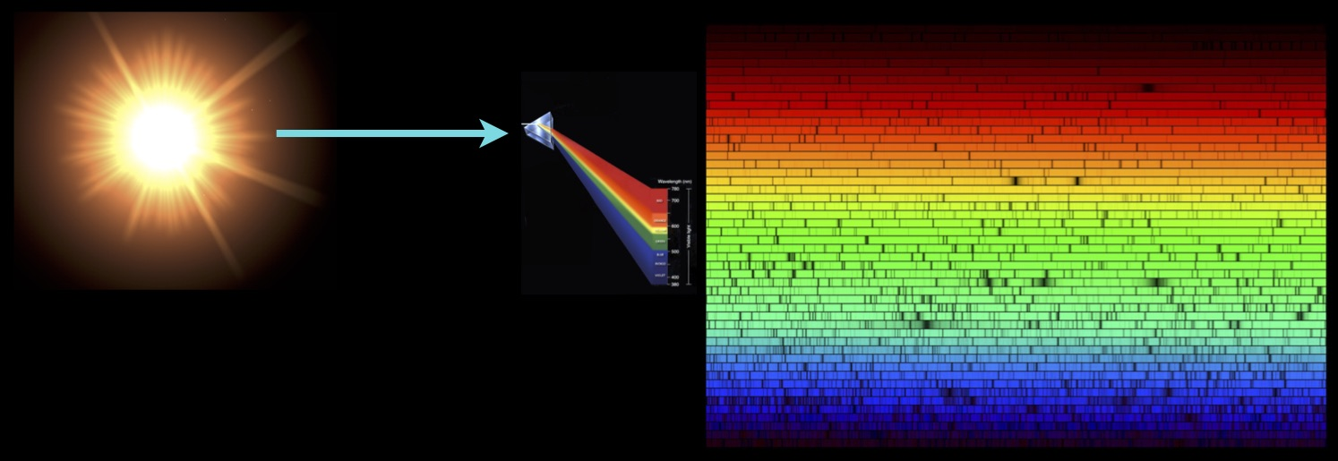
Spectrum as Astrophysical fingerprint

Slide 10
Forbidden emission lines
(highly improbable)
Collisionally excited lines excited by collisions with thermal electrons not by photon absorption.
The emissions result from electrons in long-lived energy states.
High density, more Collisions de-excitation, line is not seen.
Observed in low density environments.

Slide 11
Line Broadening
Broad Lines HIGH VELOCITIES
(1000km/sec)
Narrow Lines LOW VELOCITIES
(300-500km/sec)

Slide 12
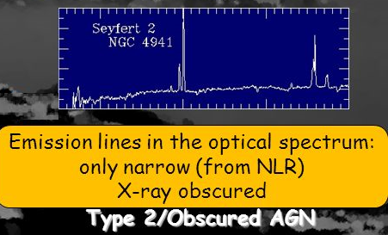
Type 2 objects are dimmer and more severely contaminated by the host galaxy spectral contributions.
Lower velocities
+
Low density

Slide 13
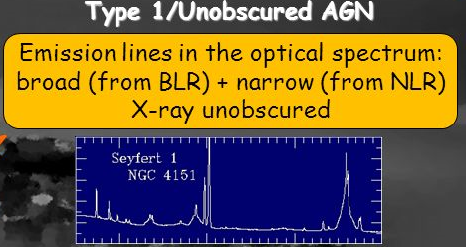
Type 1 sources are brighter and they commonly show a thermal UV excess
`Narrow line
+
Broad line
Combination

Slide 14

Most of the relevant physical processes involved in the accretion and in the acceleration of jets are confined close to the SMBH, in a region that lies still beyond the resolution capabilities of present day instruments.

Slide 15

Most of the relevant physical processes involved in the accretion and in the acceleration of jets are confined close to the SMBH, in a region that lies still beyond the resolution capabilities of present day instruments.

Slide 16
Analyze their spectra !!

Slide 17
Not all sources are equally good for such investigations.
Type 1 objects
Tend to be dominated by the emission of the AGN
Type 2 objects
strongly
affected by obscuration
and stellar light
contributions from the
host galaxy.

Slide 18
To understand the physics of AGN
We need a careful inspection of spectral properties extended over large statistical samples in order to compare the predictions of different models with the available observations

Slide 19
What did we do?
We describe
A revised scheme to select AGNs based on the properties of their emission lines and colors.
We illustrate
The potential of multi-frequency models to relate the observed Spectral Energy Distributions (SEDs) with optical spectra.
We discuss
The information that we are able to extract on their central structures from the combined analysis of line profiles and multi-frequency data.

Slide 20
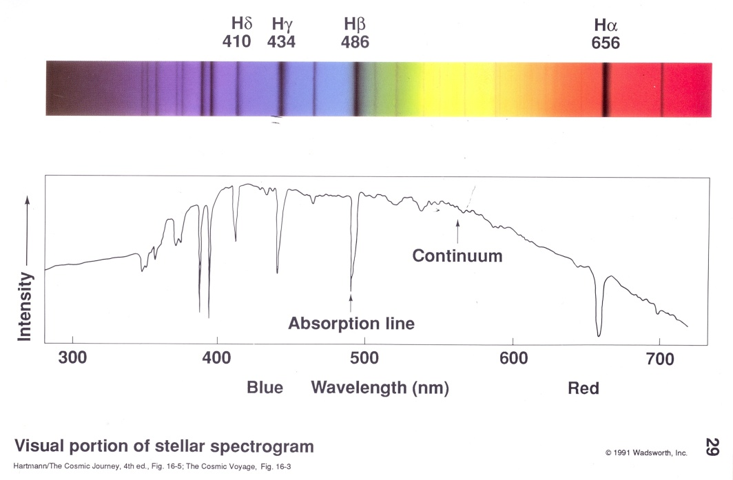
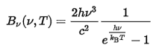
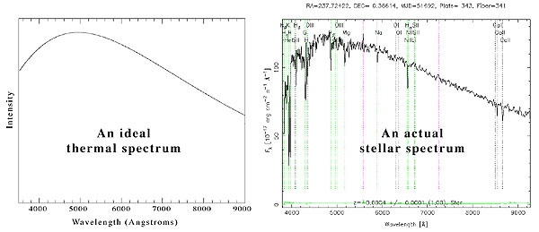
Different objects have different spectra
STARS
Thermal source: Blackbody continuum.
Stars=Blackbody continuum+ Absorption.

Slide 21
Different objects have different spectra
The Spectra has temperature
And frequency dependence

Slide 22
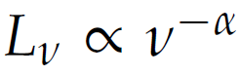
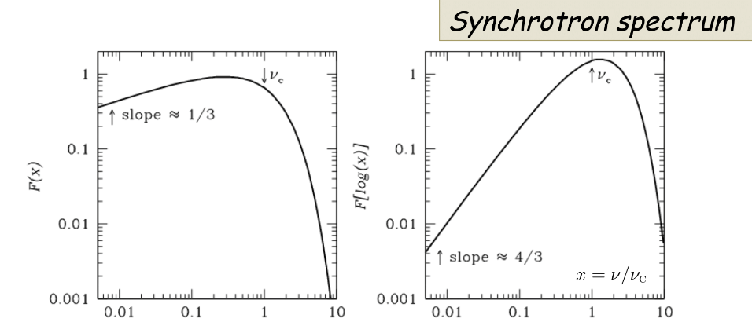
Non Thermal source: Power law continuum.
Characteristics of the emitted radiation do not depend on the temperature of the source.
Ex: Synchrotron, Compton, etc….

Slide 23
Non Thermal source: Power law continuum.
The Spectra has only
frequency dependence
AGNs
Characteristics of the emitted radiation do not depend on the temperature of the source.
Ex: Synchrotron, Compton, etc….

Slide 24

AGNs
Penetrate deeply into the predominantly neutral region.
Produce a large partly ionized zone
This extended zone of partly ionized H does not exist in H II regions photo ionized by hot stars.

Slide 25
AGNs
Atoms+ions+hot free X-ray photoionized e-
Collisional excitation
Stronger forbidden lines than
H alpha or H beta

Slide 26
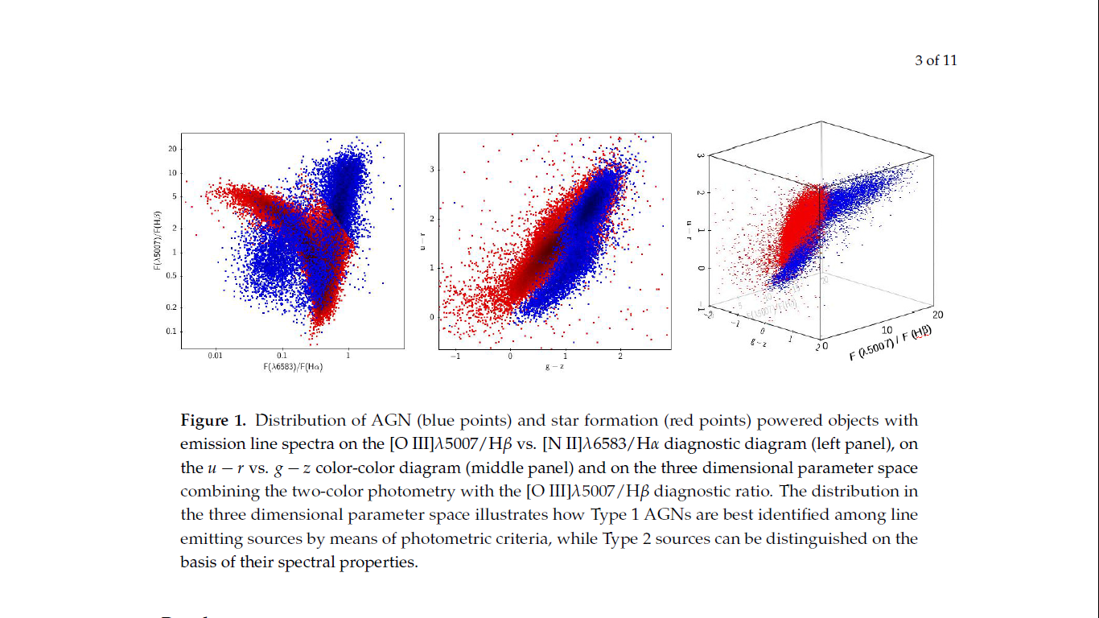
Results
AGN selection from spectroscopic surveys:
Revision of the selection technique…..why?
NARROW LINE EMITTING Source fairly well suited to distinguish between AGN and stellar activity.
SELECTION OF SPECTRA SIMPLY
BASED ON THE PRESENCE OF
EMISSION LINES
The presence of a strong contribution
in the broad component of the recombination
lines in Type 1 objects, which is not balanced
in the forbidden lines, forces Type 1 sources to
populate the non-AGN region of the plots.
Red -star formation
Blue-AGN

Slide 27
Results
AGN selection from spectroscopic surveys:
Take advantage from the strong blue and UV continuum, which is produced by the central source and is not obscured along the line of sight.
Type 1 AGNs can effectively be selected by means of photometric
criteria that compare their colors with those of non-active objects.
The choice of this extended color
bands maximizes the effect of the
blue continuum of Type 1 sources,
over the stellar continuum of other
sources.

Slide 28
Result
We recover the possibility to detect different types of nuclear activity
Classic spectroscopic diagnostics + photometric colors into a
multi-dimensional parameter space
AGNs populate a separate sequence with respect to other non-AGN powered sources.

Slide 29

My contribution

Slide 30
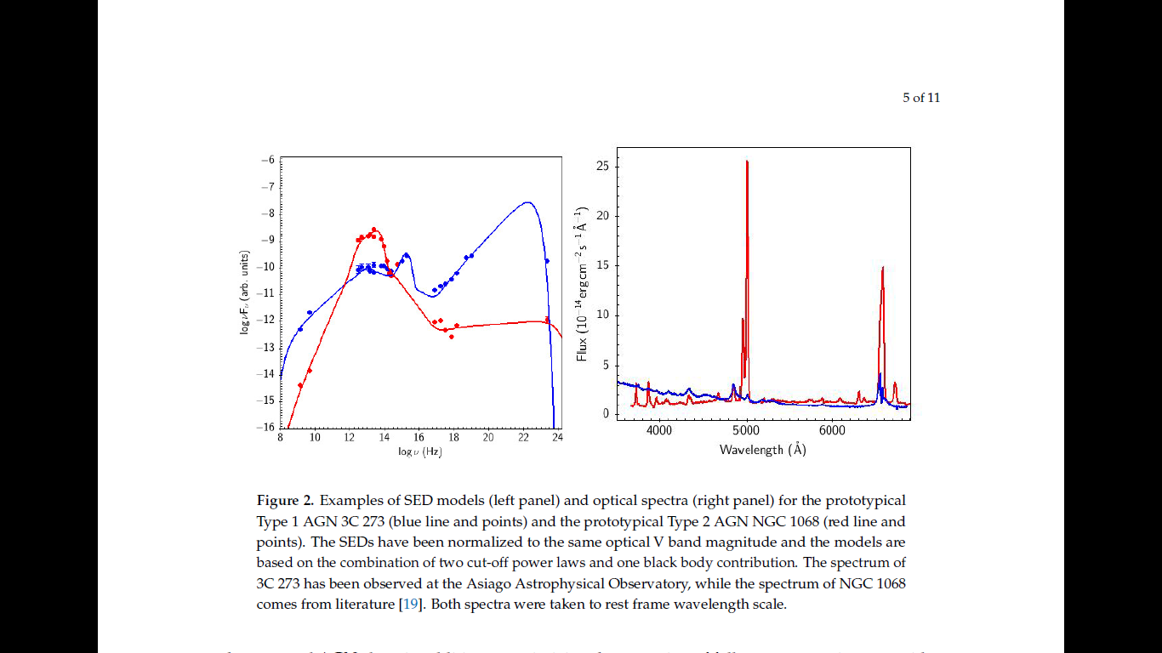
Emission lines and models of AGN Spectral Energy Distributions
In short……..
Combine available data
And reconstruct SED
Compare with the associated optical
spectra
Type1-BLUE Type-2-RED
Different SEDs of two prototypical AGNs (3C 273 for Type 1 and NGC 1068 for Type 2)
modelled through a combination of thermal and non-thermal radiation components,
together with their characteristic spectra.

Slide 31
Emission lines and models of AGN Spectral Energy Distributions
Type 1 spectrum
broad lines + blue continuum +
a strong dominance
of the non-thermal contribution
direct sight towards the hottest
central regions, resulting in an excess
of ionizing radiation, in agreement
with the Unified Model predictions.
Type 2 SED
low energy ionizing radiation is severely absorbed and reprocessed by a distribution of material that subsequently re-emits photons in the IR domain.
Only the more penetrating high-energy photons and the long wavelength radio emission, which is practically unaffected by obscuration, can propagate directly from the central source
therefore resulting in a optical spectrum that is dominated by the host galaxy and the emission lines coming from the unobscured NLR.

Slide 32
Emission lines and models of AGN Spectral Energy Distributions
Type 1 spectrum
broad lines + blue continuum +
a strong dominance
of the non-thermal contribution
direct sight towards the hottest
central regions, resulting in an excess
of ionizing radiation, in agreement
with the Unified Model predictions.
agreement with the Unified Model
predictions
Type 2 SED
low energy ionizing radiation is severely absorbed and reprocessed by a distribution of material that subsequently re-emits photons in the IR domain.
Only the more penetrating high-energy photons and the long wavelength radio emission, which is practically unaffected by obscuration, can propagate directly from the central source
therefore resulting in a optical spectrum that is dominated by the host galaxy and the emission lines coming from the unobscured NLR.

Slide 33
Multi-frequency analysis of the central engine
Extremely compact size of the regions where the continuum and the bulk of emission lines are produced in AGNs, we do not yet have a fully developed interpretation of their innermost structures.
Analysis of spectra + models that carry out the inferred physical conditions.
the extension of spectroscopic analysis to different frequencies improves our ability to explore unresolved structures.

Slide 34
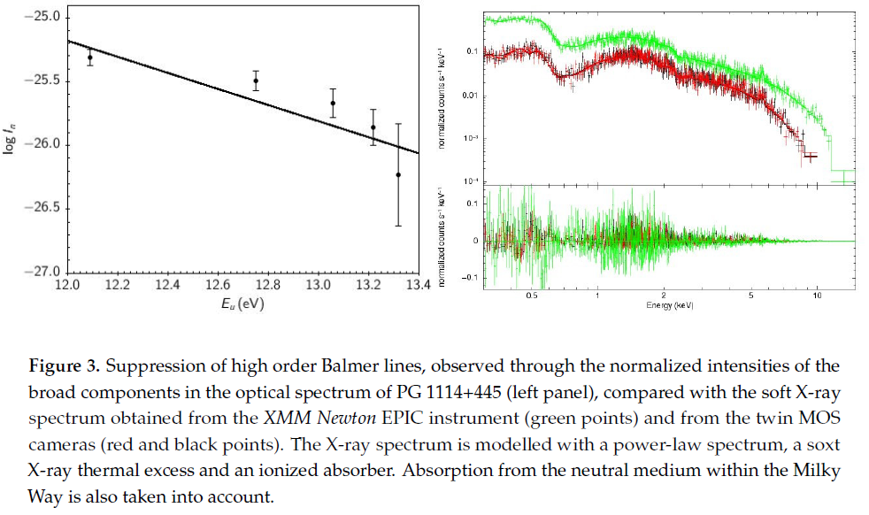
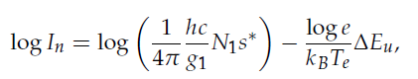
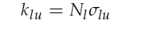
Multi-frequency analysis of the central engine……… QSO PG 1114+445
Optical VS soft X-ray
Assumptions
Distribution of emitting atoms is spatially constant within the source and that it can be represented by a Boltzmann formula at least in the high excitation stages
EXPECTATION??
REALITY !!
Absorprtion
Thick ionised plasma…High column density.
We expect….Balmer lines due to recombination
So, we the X-ray absorbers are located outside BLR, they will absorb BALMER LINES AS WELL obscuring material

Slide 35
The deviation from the expected linear behavior observed indication that the flux of high order Balmer line photons is lower than the prediction.
optical depth effects become important in determining the relative strengths of the recombination lines.
which can happen in the presence of a dense layer of recombining plasma.

Slide 36

The possibility to detect different types of nuclear activity Classic spectroscopic diagnostics + photometric colors.
Multi-frequency analysis of the central engine evidence of obscuring material
Unified Model – Type 1 and type 2 can be though as “same” but “seen differently”.

Slide 37
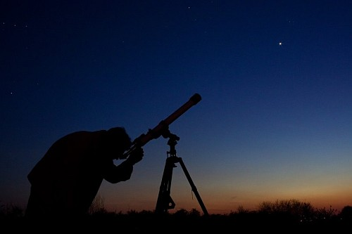
Thank you !

Slide 38


