Slide 1

Virial theorem in astrophysics
Marina Pavlović
Department of Physics
Faculty of Sciences, University of Novi Sad

Slide 2
The Virial theorem in astrophysics
The classical derivation of the Virial Theorem
The Variational Form of the Virial Theorem
Some Applications of the Virial Theorem in
stellar astrophysics
Applications of the Virial Theorem in modern physics

Slide 3
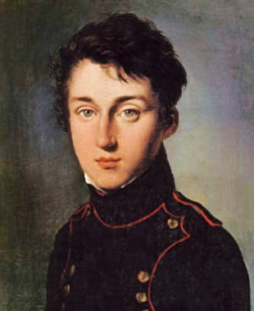
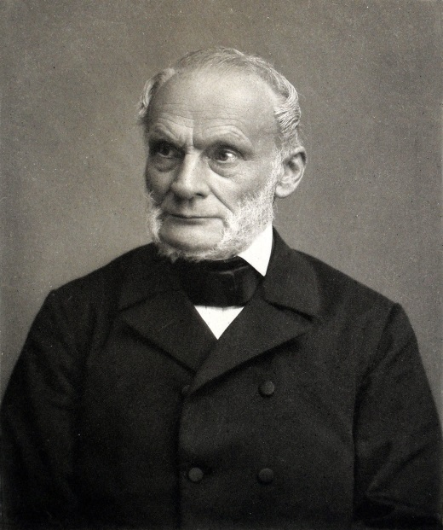
The classical derivation of the Virial Theorem
- Earliest clear presentation of the Virial theorem.
Nicolas Léonard Sadi Carnot
Rudolf Clausius
- Average kinetic energy is equal to 1/2 the average potential energy.
- Systems can be described by solving the force equations representing
the system.
- The Virial theorem generally deals with scalar quantities.

Slide 4
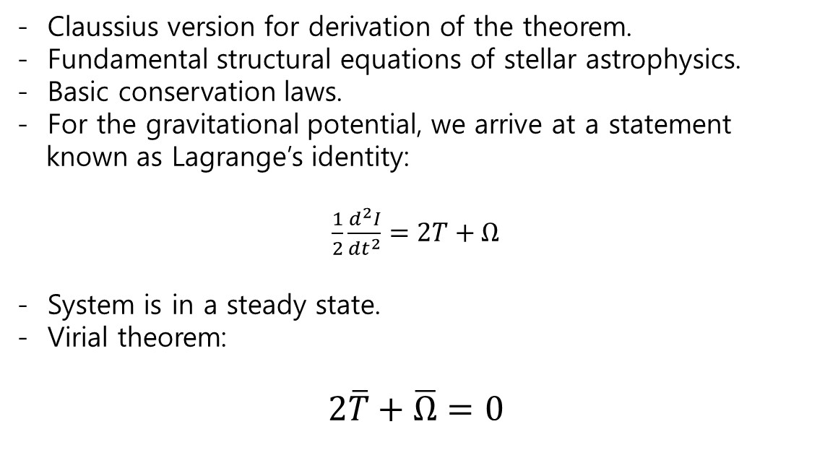
The classical derivation of the Virial Theorem
- Claussius version for derivation of the theorem.
- Fundamental structural equations of stellar astrophysics.
- Basic conservation laws.
- For the gravitational potential, we arrive at a statement
known as Lagrange’s identity:
$\frac{1}{2}\frac{d^{2}I}{dt^{2}}=2T+Ω$
- System is in a steady state.
- Virial theorem:
$$2\overline{T}+\overline{Ω}=0$$

Slide 5
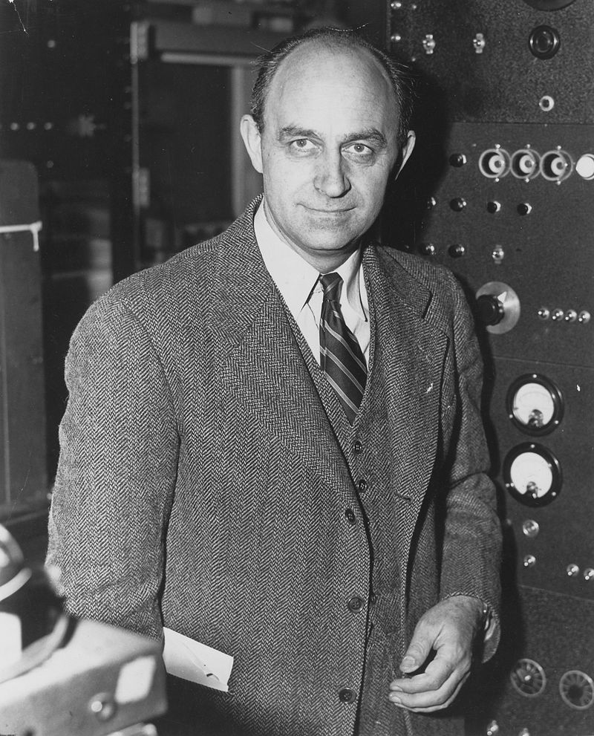
The Variational Form of the Virial Theorem
- The variational approach yields differential equations which
describe parameter relationships for a system disturbed from an
initial state.
- Ledoux determed the pulsational period of the star.
- Chandrasekhar and Fermi investigated the effects of a magnetic
field on the pulsation of a star.
Enrico Fermi

Slide 6
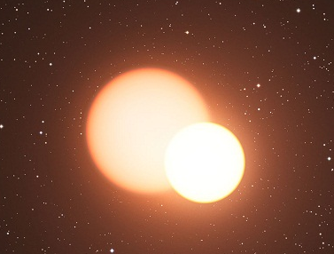
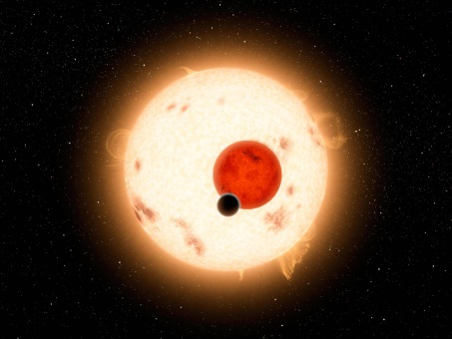
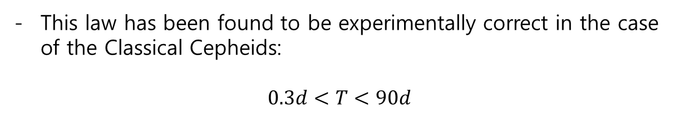

Radial Pulsations for Self-Gravitating Systems: Stars
- Frequency of radial pulsations in a gas sphere.
- The motion is simply periodic.
- The pulsation increases radially outwards in a linear manner.
- Equation for pulsational period takes simple form:
$$T=\left(\sqrt{\frac{4π}{3G}}\right)ρ^{−\frac{1}{2}}$$
This law has been found to be experimentally correct in the case of the Classical Cepheids:
$$0.3d<T<90d$$

Slide 7
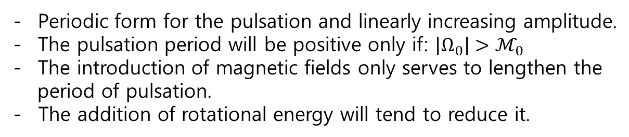
The Influence of Magnetic and Rotational Energy upon a Pulsating System
Frequency of pulsation of that system.
All deviations from equilibrium shall be small.
Radiation pressure will be considered to be negligible.
$$\frac{1}{2}\frac{d^{2}I}{{dt}^{2}}=2T_{к}+Ω+ℳ$$
Periodic form for the pulsation and linearly increasing amplitude.
The pulsation period will be positive only if: $\left|Ω_{0}\right|>ℳ_{0}$
The introduction of magnetic fields only serves to lengthen the
period of pulsation.
- The addition of rotational energy will tend to reduce it.

Slide 8
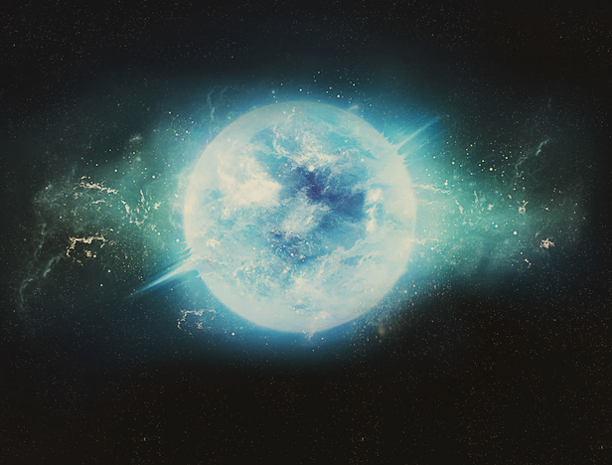

Some Applications of the Virial Theorem:
Pulsational Stability of White Dwarfs
- White dwarf become unstable when its radius shrank to about
246 Schwarzschild radii or 1000km.
- Spherically symmetric equation of motion.
- Again, we form LI and its variation.
- We can write eq for stability of white dwarfs as:
$$\left({R_{0}}/{R_{S}}\right)>228{\left({M_{0}}/M\right)}^{4/9}≅200$$

Slide 9

The Influence of Rotation and Magnetic Fields on White Dwarf Gravitational Instability
- Strong gravitational field.
- The case for rigid rotation.
- Stability conditions:
$${\left(\frac{R_{0}}{R_{s}}\right)}^{3}+\left(\frac{R_{0}}{R_{s}}\right)\frac{4.4∙{10}^{4}w^{2}}{\left(1−ℋ^{2}\right)}−\frac{9.3∙{10}^{−6}}{\left(1−ℋ^{2}\right)}>0$$
For the field to make any noticeable difference it will have to
be truly large.
Neither magnetic fields nor rotation can significantly alter the
fact that a white dwarf will become unstable at or about
1000km.

Slide 10
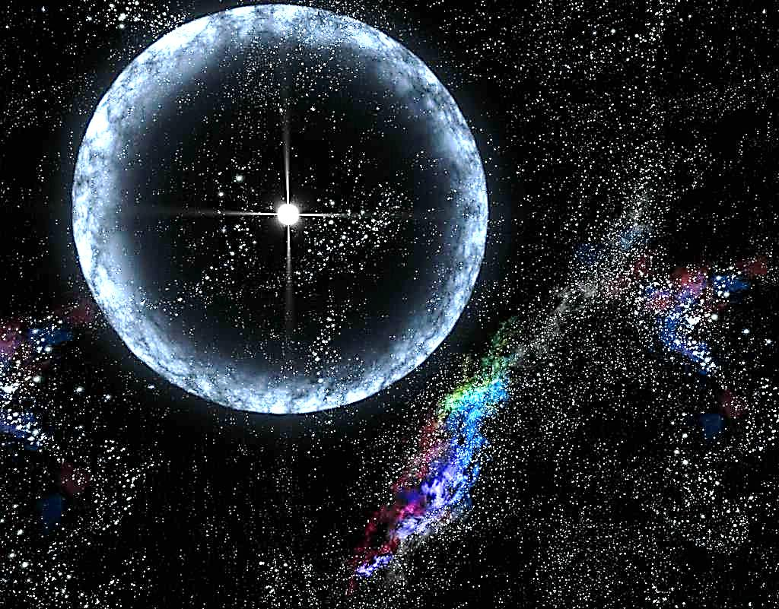

Stability of a Neutron Star
- The electrons achieve relativistic velocities.
- Let us ignore the effects of general relativity and just consider the
special relativistic Virial theorem.
- Stability conditions:
$$\left(\frac{R_{0}}{R_{s}}\right)>4.3$$
R_{o} for a neutron star would have to be greater than about 12km
- The effects of magnetic fields and rotation are qualitatively the
same for neutron stars as for white dwarfs.

Slide 11
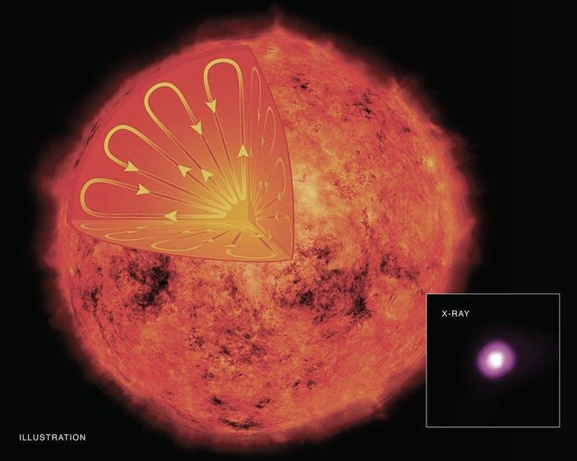

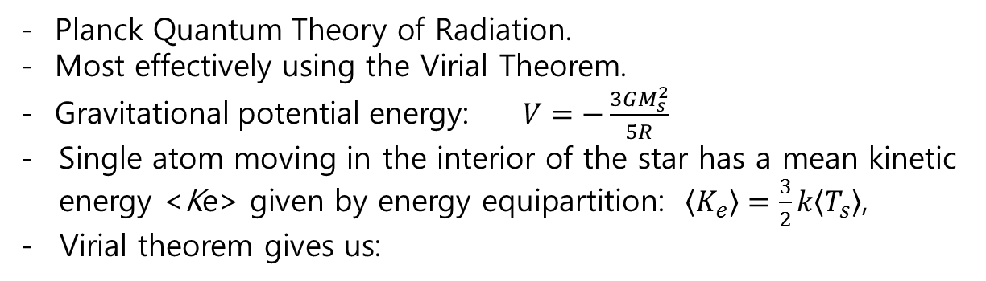
Applications of the Virial Theorem in modern physics: Temperature of the interior of a star
- Planck Quantum Theory of Radiation.
- Most effectively using the Virial Theorem.
- Gravitational potential energy: $V=−\frac{3GM_{s}^{2}}{5R}$
Single atom moving in the interior of the star has a mean kinetic energy <Ke> given by energy equipartition: $〈K_{e}〉=\frac{3}{2}k〈T_{s}〉$,
- Virial theorem gives us:
$$〈T_{s}〉≈\frac{GM_{s}^{2}}{5kNR}=\frac{GM_{s}^{2}m}{5kR}$$

Slide 12
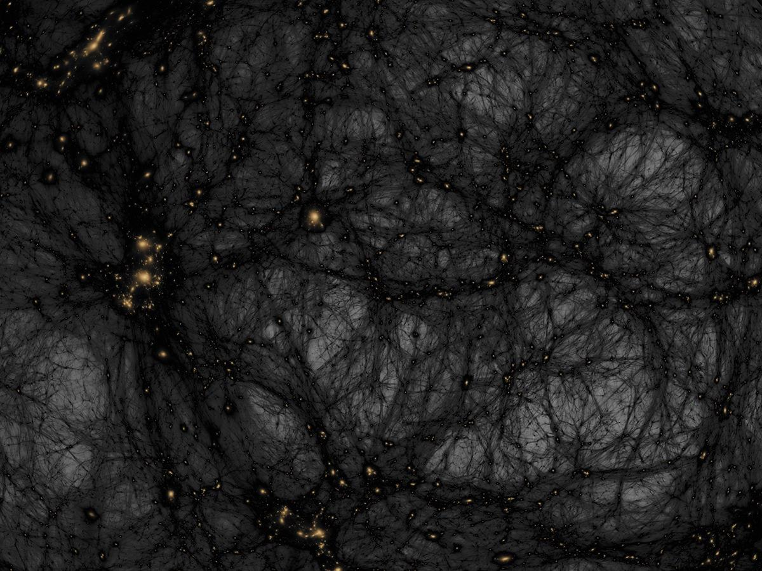
Applications of the Virial Theorem in modern physics: The dark matter hypothesis
A cluster of galaxies.
- The main portion of luminous and observable matter
in a thin disk.
Gravitational force = Centripetal force.
The velocity of the star depends on the mass of the galaxy.
Applying the Virial Theorem to each star:
$$σ_{r}^{2}≈\frac{GM_{virial}}{5R}$$
Electro-magnetic spectrum analysis.
F. Zwicky found that there was about 100 times more mass than the expected one given by the spectrum analysis.

Slide 13
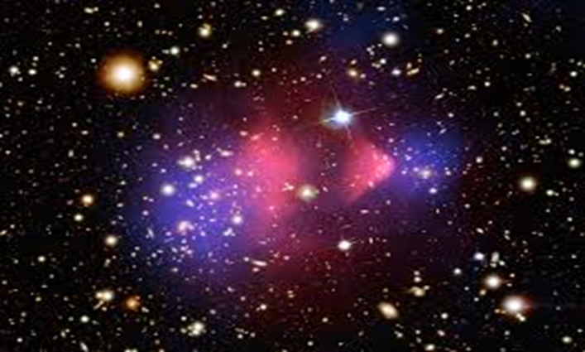
Bullet Cluster
A clash of two
galaxies
- The clash caused a
strong separation of
the individual
components
- The homogeneously
distributed gas clouds
interacted significantly
Bullet Cluster, blue: gravitational potential, red: x-ray emitting gas
- The maximum of the gravitational potential is not the maximum
of the visible matter density.
- Dark matter!

Slide 14
Conclusion
Average kinetic energy is equal to 1/2 the average potential energy.
Frequency of radial pulsations in a gas sphere. (pulsational period)
The introduction of magnetic fields only serves to lengthen the
period of pulsation.
The addition of rotational energy will tend to reduce it.
Equations for stability of white dwarfs and neutron stars.
Temperature of the interior of a star.
The dark matter hypothesis.

Slide 15
Thank you for your attention
https://www.df.uns.ac.rs/files/200/marina_pavlovic_-_diplomski_rad_(d-).pdf

